Slide 1
Introduction to Machine Learning
ELL784 | Assignment 3
Shivangi Bithel, Yukti Kaura, Vishnu Gorty

Slide 2
Index
Polynomial Curve Fitting
Genomic Sequence Analysis

Slide 3
Polynomial Curve Fitting

Slide 4
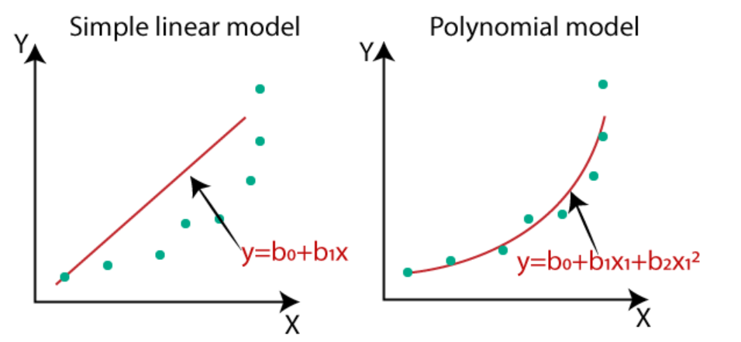
Introduction
Polynomial Regression is a form of linear regression in which the relationship between the independent variable x and dependent variable y is modeled as an nth degree polynomial. Polynomial regression fits a nonlinear relationship for e.g. progression of disease epidemics
Here y is dependent variable on x, a is y intercept and e is the error rate.
In general, we can model it for nth value.
y = a + b1x + b2x^2 +....+ bnx^n + ϵ
Since regression function is linear in terms of unknown variables, hence these models are linear from the point of estimation.

Slide 5
Problem Statement
To begin with, use only the first 20 data points in your file.
Solve the polynomial curve fitting regression problem using error function minimisation.
Define your own error function other than the sum-of-squares error.
Try different error formulations and report the results.
Use a goodness-of-fit measure for polynomials of different order.
Can you distinguish overfitting, underfitting, and the best fit?
Obtain an estimate for the noise variance.
Introduce regularisation and observe the changes. For quadratic regularisation, can you obtain an estimate of the optimal value for the regularisation parameter lambda? What is your corresponding best guess for the underlying polynomial? And the noise variance?
Now repeat all of the above using the full data set of 100 data points.
How are your results affected by adding more data? Comment on the differences.
What is your final estimate of the underlying polynomial? Why?

Slide 6
Data Description
Dataset - https://www.cse.iitd.ac.in/~sumantra/courses/ml/a3/group01.txt
Data of the form (x_i, y_i) for i = 1, ... 100. The relationship between x and y is of the form: y = w_0 + w_1 x + ... + w_M x^M + e. The error e is drawn from a Gaussian distribution with zero mean and unknown (but fixed, for a given input file) variance. M is also unknown.
Sample data(10 points):
x y
-4.94 1039755.18
-4.89 953776.95
-4.84 874074.10
-4.73 718895.29
-4.71 693432.09
-4.33 338012.90
-4.15 234701.23
-4.09 207027.09
-3.95 153242.63
-3.68 82835.16
Number of data points: 100
X ranges from : -4.94 to 4.92
Y ranges from : 1.21 to 2254025.74

Slide 7
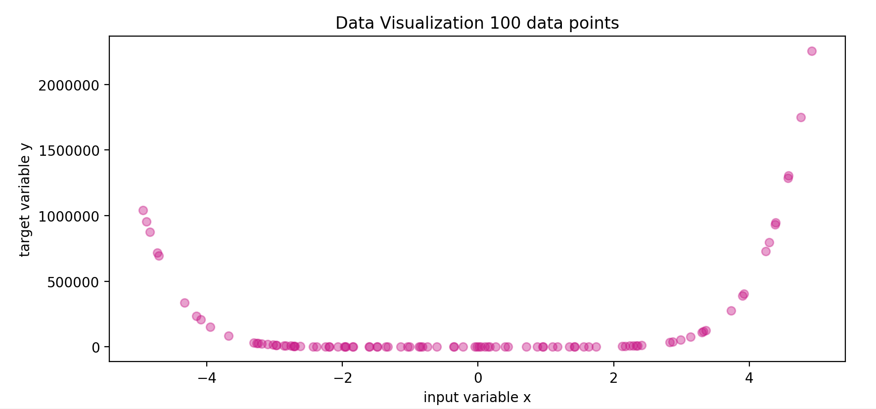
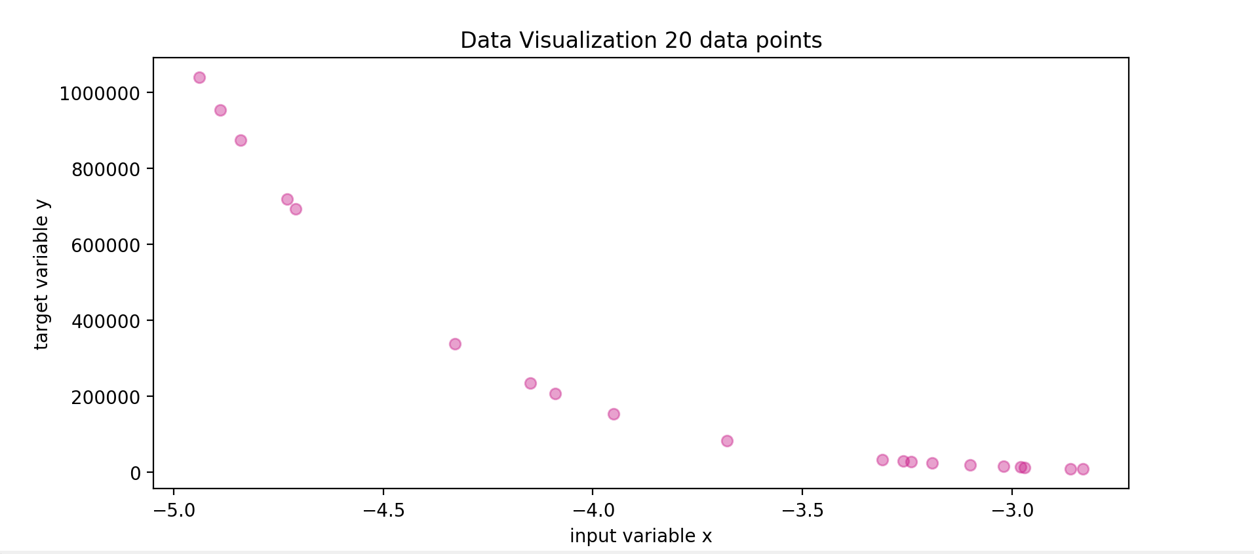
Data Visualization
100 data points
X range: -4.94 to 4.92
Y range: 1.21 to 2254025.74
20 data points
X range: -4.94 to -2.83
Y range: 7990.54 to 1039755.18

Slide 8
Process Overview
Polynomial Degree Range : 0 to 10
Lambda Range ƛ: 1e-3 to 1e2
Cross Validation constant (k) : 5
For each degree in degree range do:
Fit model
Calculate performance metrics over k-folds (and alpha, if regularized)
Select the degree(and alpha, if regularized) which yields best goodness of fit

Slide 9
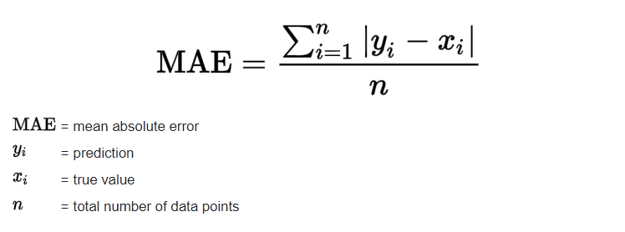
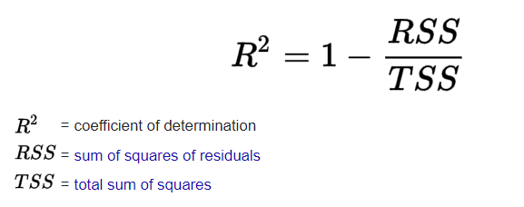
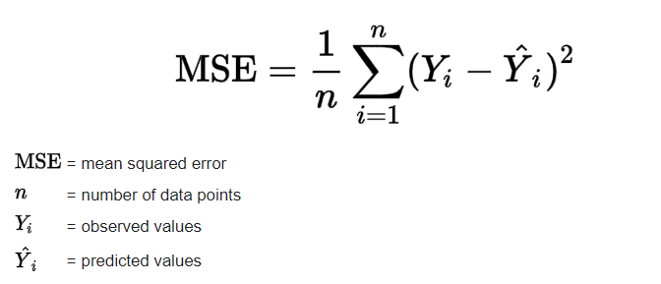
PERFORMANCE METRICS
Mean Absolute Error
3. Goodness of Fit ( R² )
0 ≤ R² ≤ 1[Generally]
2. Mean Square Error
R² is used to quantify the amount of variability in the data that is explained by the model.
Large differences between actual and predicted are punished more in MSE than in MAE.

Slide 10
Polynomial Regression

Slide 11
20 Data Points
Data with top 20 data points

Slide 12
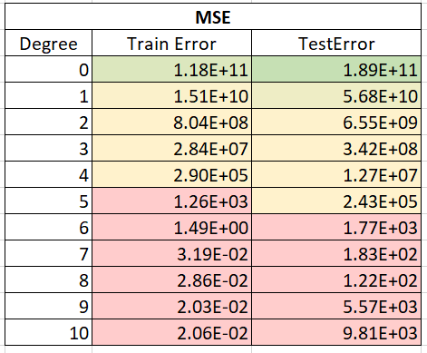
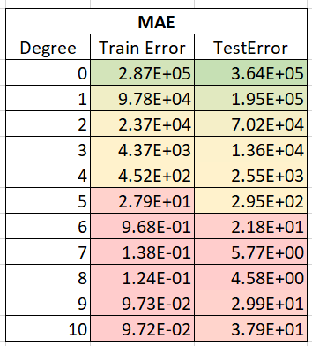
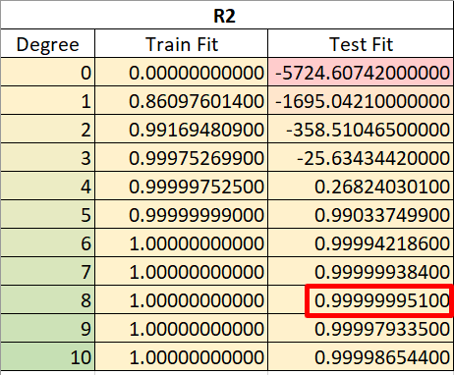
Errors and Goodness of Fit
As is seen for degree 8, R2 value is maximum we choose the degree 8 as the degree of the model
Optimal degree = 8

Slide 13
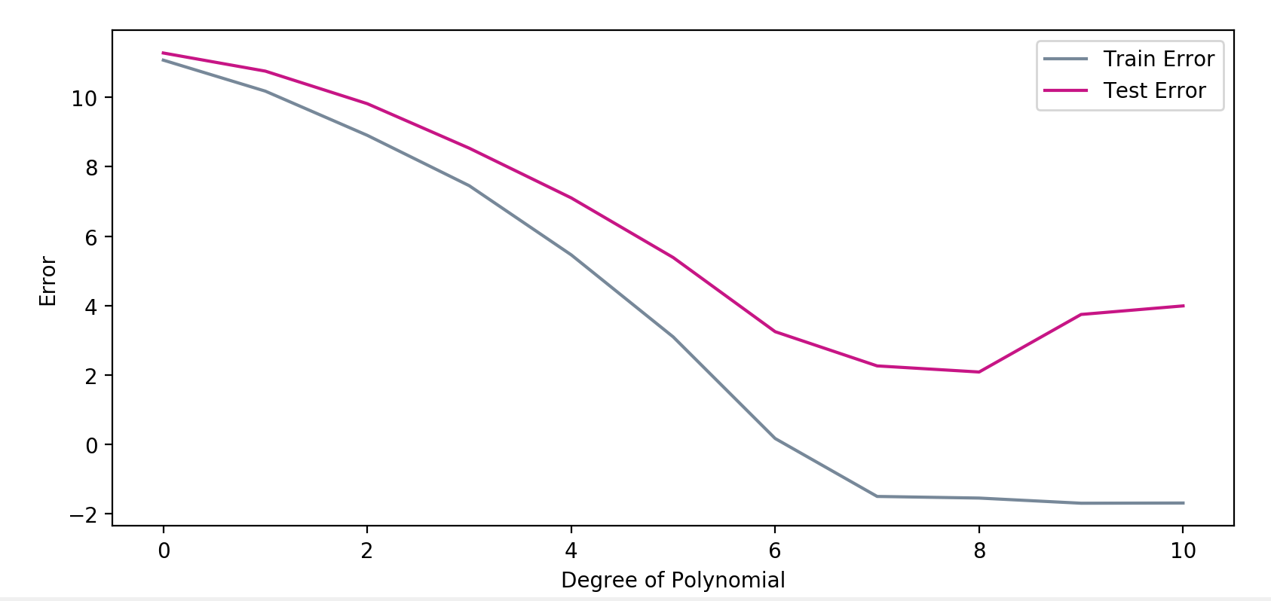
FIT OF THE MODEL
Degree = 0 : Train & Test error both are very high : UNDERFIT
Degree > 8 : Train error is low & Test error is high : OVERFIT
Degree = 8 : both Train & Test are stable and minimum : BEST-FIT
This correlates with the goodness fit measure .

Slide 14
FINAL POLYNOMIAL REGRESSION MODEL
Polynomial Coefficients : 0.00000000e+00 -6.25701553e+05 -6.02581129e+05 -3.29180875e+05 -1.11568325e+05 -2.40209506e+04 -3.20479316e+03 -2.34696399e+02 -3.51654246e+00
Intercept - -282167.77394048
Variance : .04421229720170674
Optimal degree: 8

Slide 15
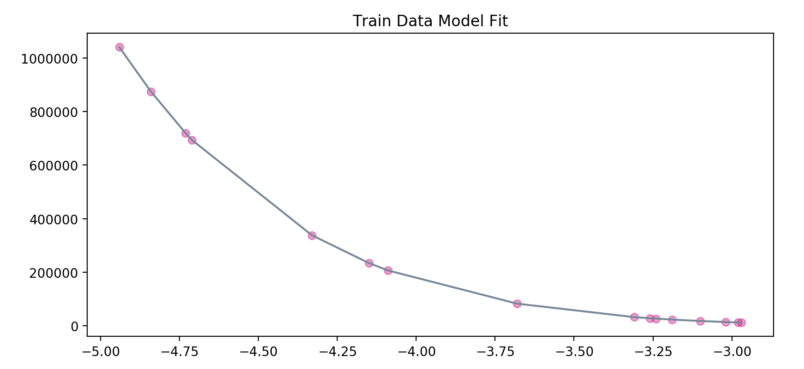
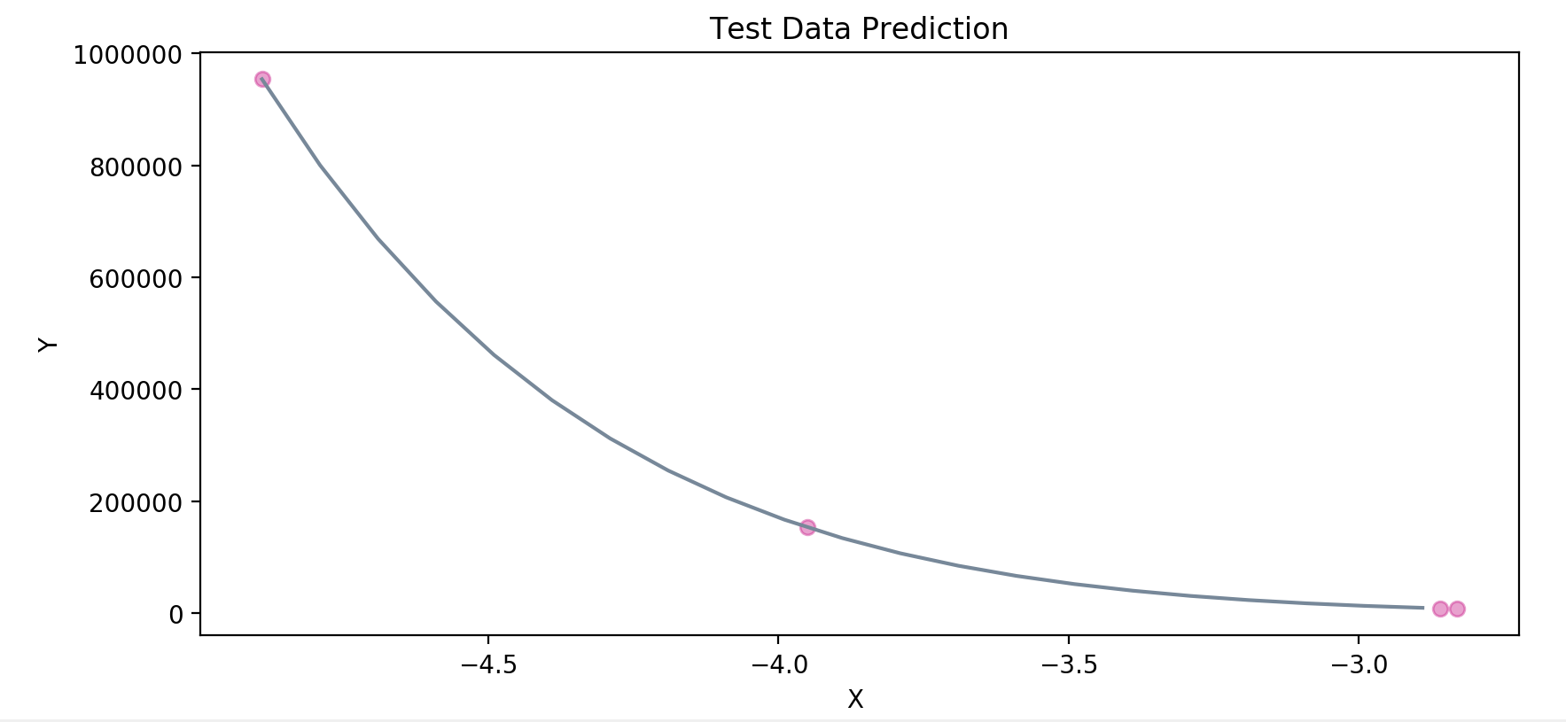
FITTING THE MODEL TO DATA
TRAIN TEST SPLIT = 80:20 (Non-Random, No Shuffle)
TRAINING SET
TEST SET

Slide 16
100 Data Points
Complete data

Slide 17
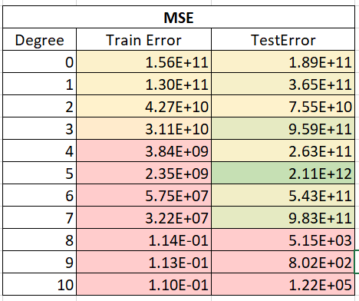
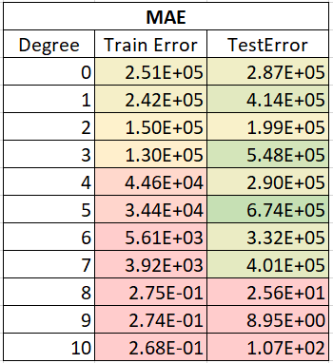
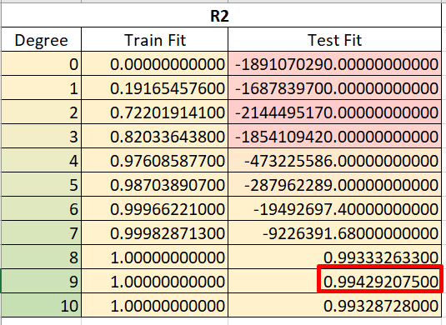
Errors and Goodness of Fit
As is seen for degree 9, R2 value is maximum we choose the degree 9 as the degree of the model
Optimal degree = 9

Slide 18
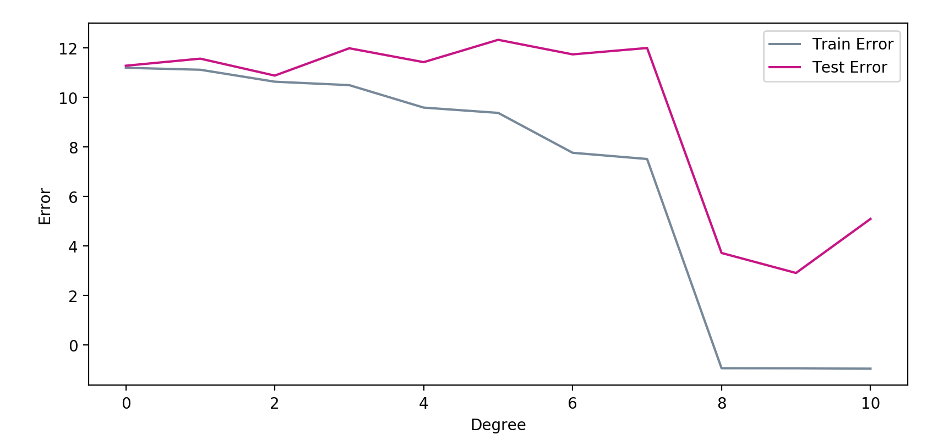
FIT OF THE MODEL
Degree = 0 : Train & Test error both are very high : UNDERFIT
Degree > 9 : Train error is low & Test error is high : OVERFIT
Degree = 9 : both Train & Test are stable and minimum : BEST-FIT
This correlates with the goodness fit measure .
9

Slide 19
FINAL POLYNOMIAL REGRESSION MODEL
Polynomial Coefficients : 0.6.93942057 8.63781465 7.07980821 5.50764703 5.80178037 5.69965776 8.69995532 4.50000523
Intercept - 7.23321344
Variance : .1152058975243086
Optimal degree: 9

Slide 20
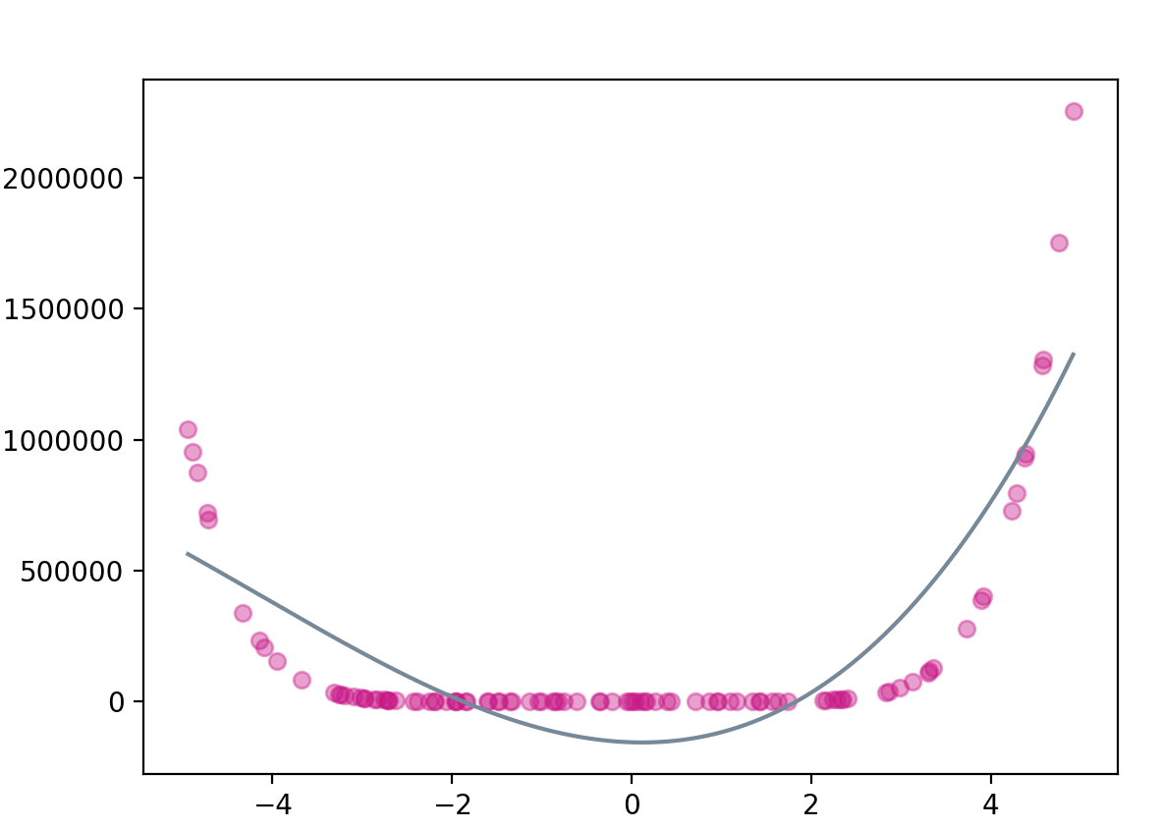
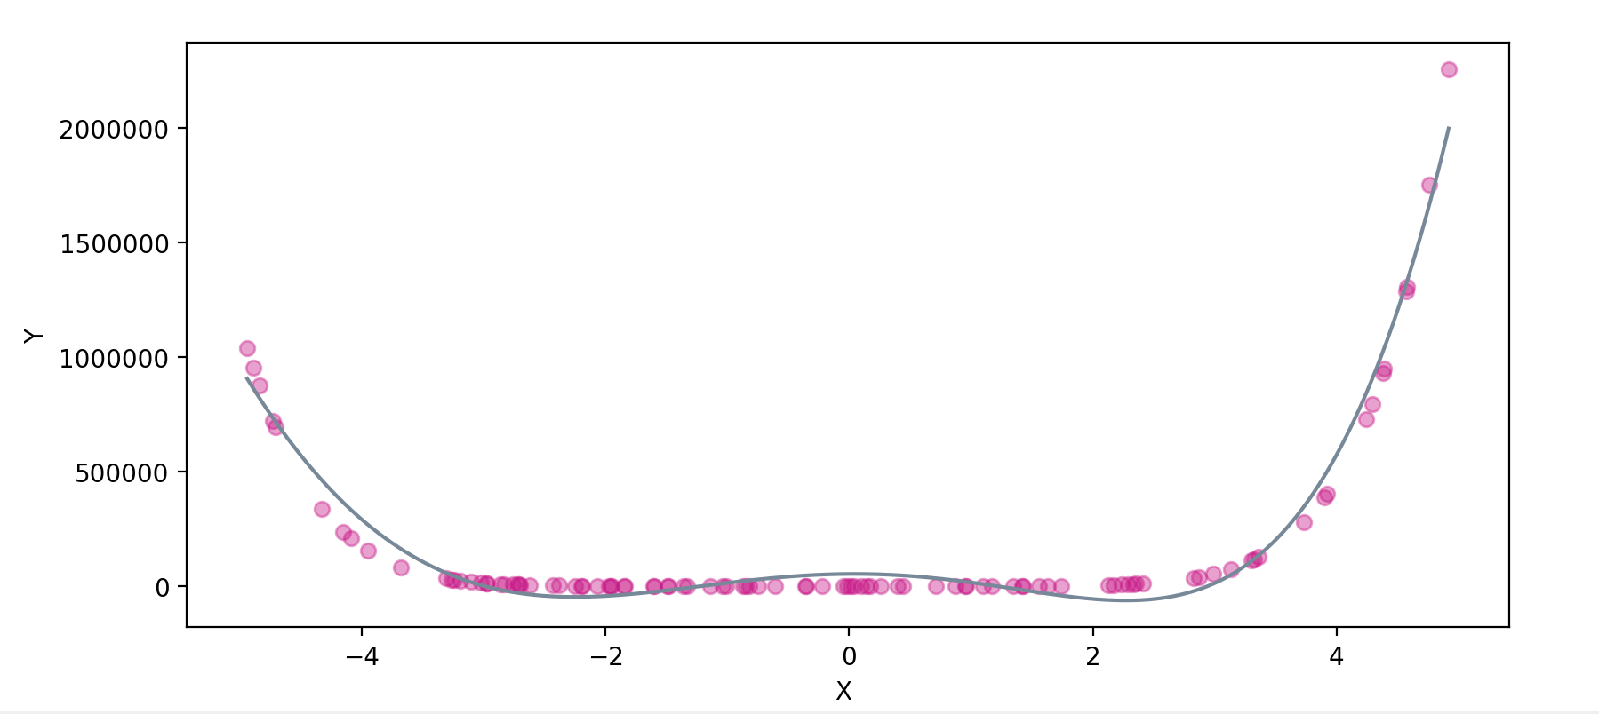
Model with less than optimal degree
DEGREE = 3
DEGREE = 5

Slide 21
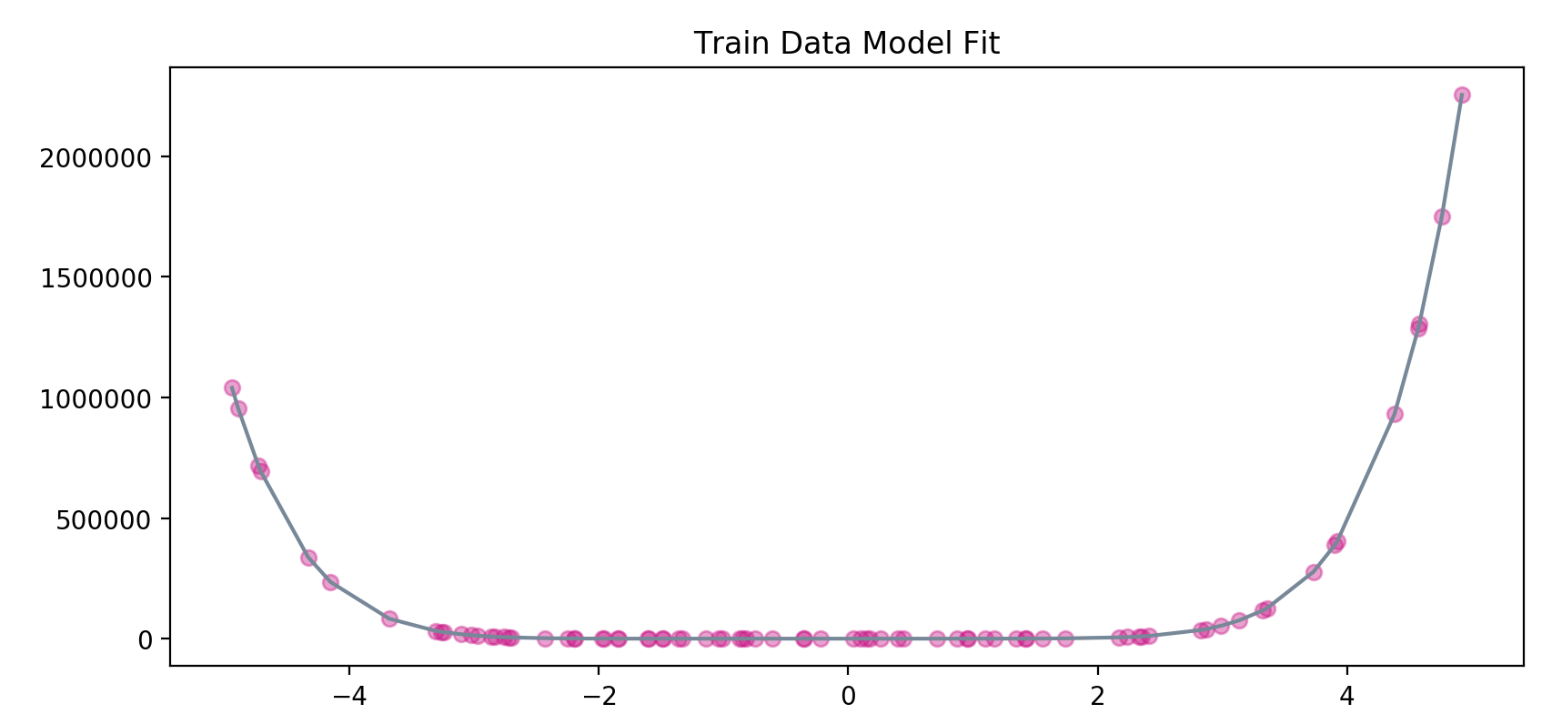
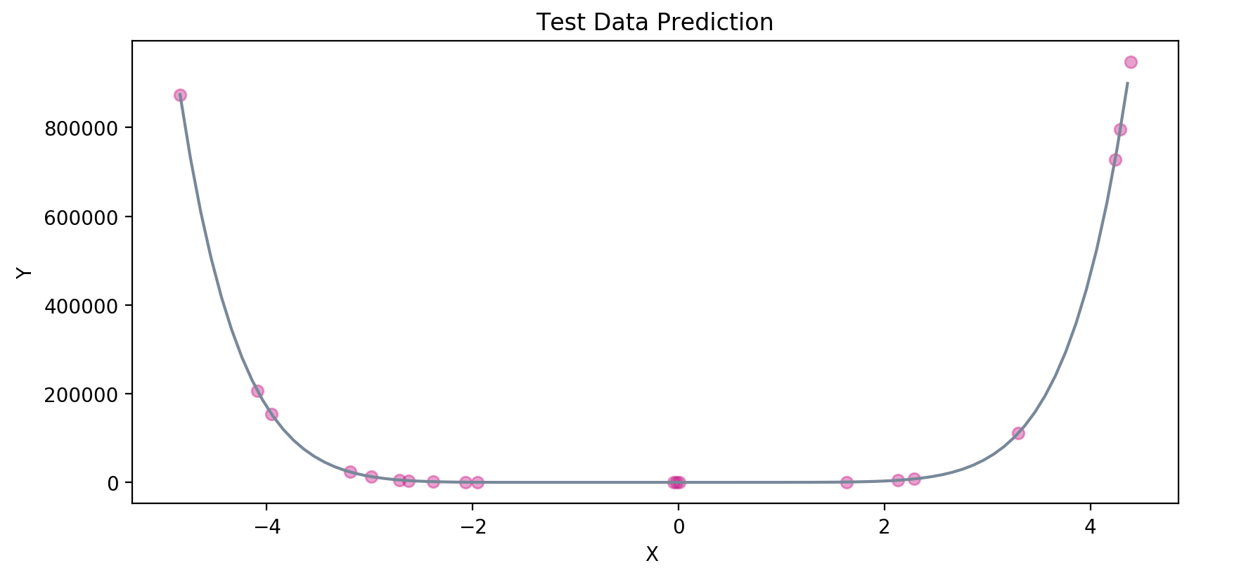
FITTING THE MODEL TO DATA
TRAIN TEST SPLIT = 80:20 (Non-Random)
TRAINING SET
TEST SET

Slide 22
Regularized Regression
(With a regularization parameter lambda)

Slide 23
20 Data Points
Data with top 20 data points

Slide 24
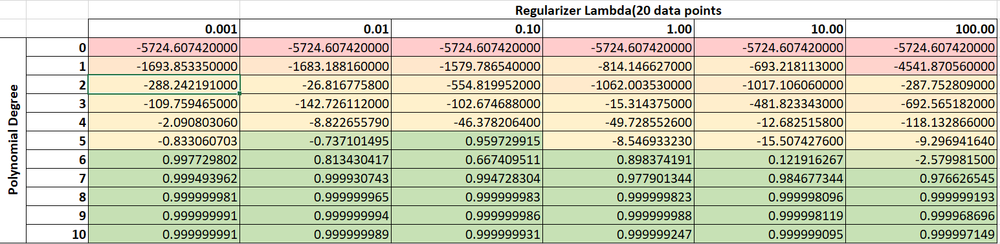
GOODNESS OF FIT(R²)

Slide 25
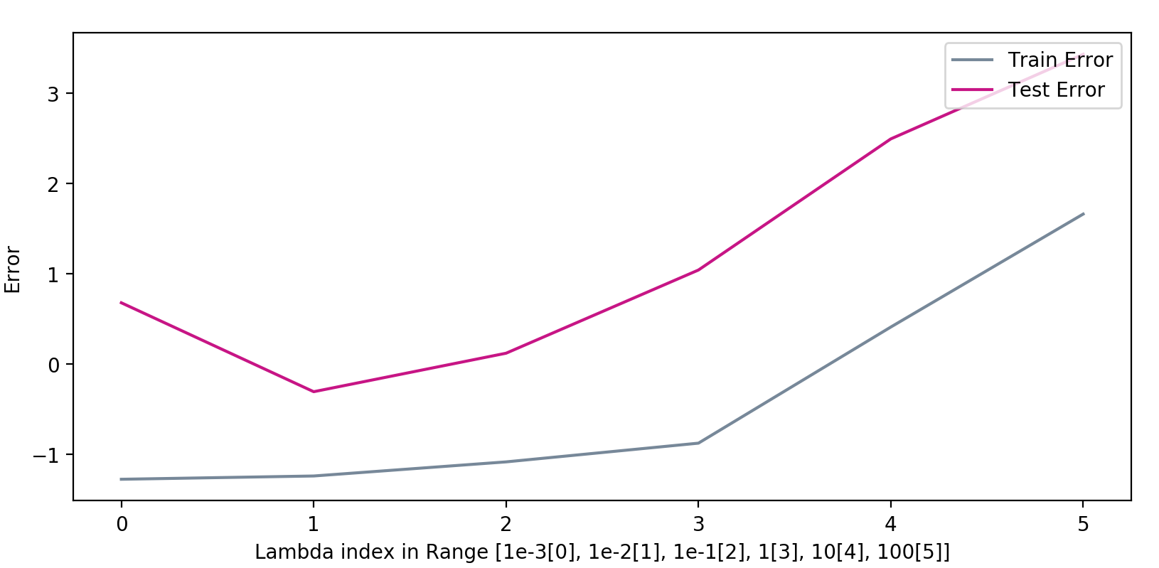
FIT OF THE MODEL
ƛ = 100 : Train and Test error both are very high : UNDERFIT
ƛ = 0.01 : Train and Test error are low: BEST-FIT.
ƛ = 0.001 : Train error is low and Test error is high BEST-FIT.
This correlates with the goodness fit measure

Slide 26
FINAL POLYNOMIAL REGRESSION MODEL
Polynomial Coefficients : 0.00000000e+00 1.49778155e-01 -4.74272849e-01 8.62626551e-01 -6.74076261e-01 -1.03036688e+00 1.91346890e+00 7.65801496e+00 4.35992945e+00 -7.38110718e-03
Intercept : -3.38420919
Variance : 0.061805574040417345
Optimal degree: 9
Optimal lambda: 0.01

Slide 27
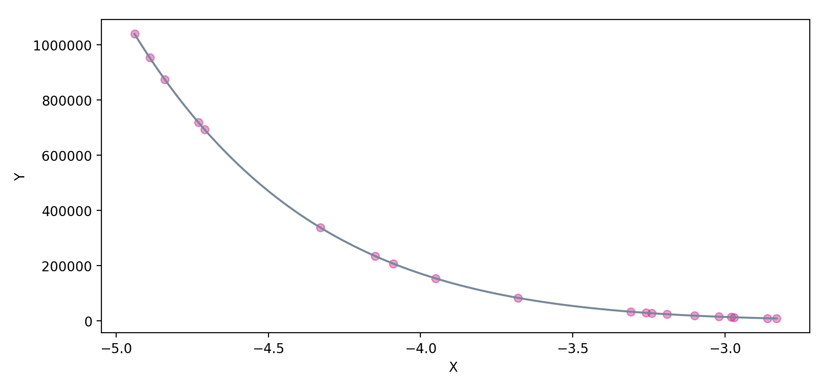
FITTING DATA TO MODEL

Slide 28
100 Data Points
Complete data

Slide 29
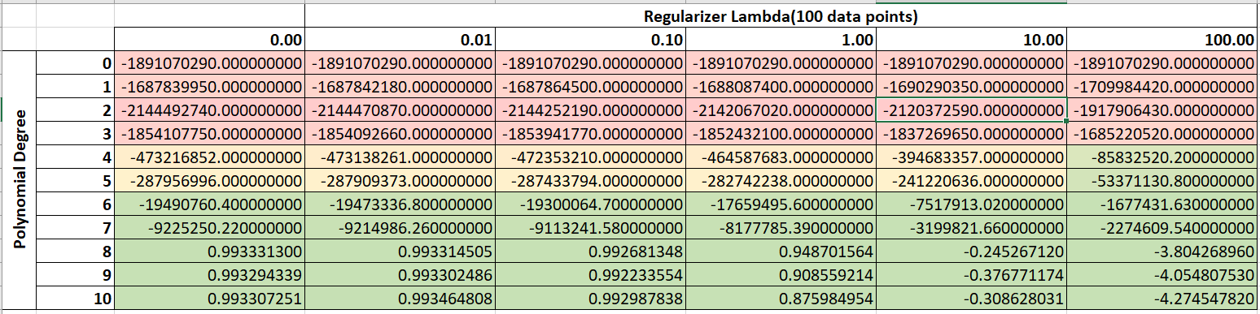
GOODNESS OF FIT(R²)

Slide 30
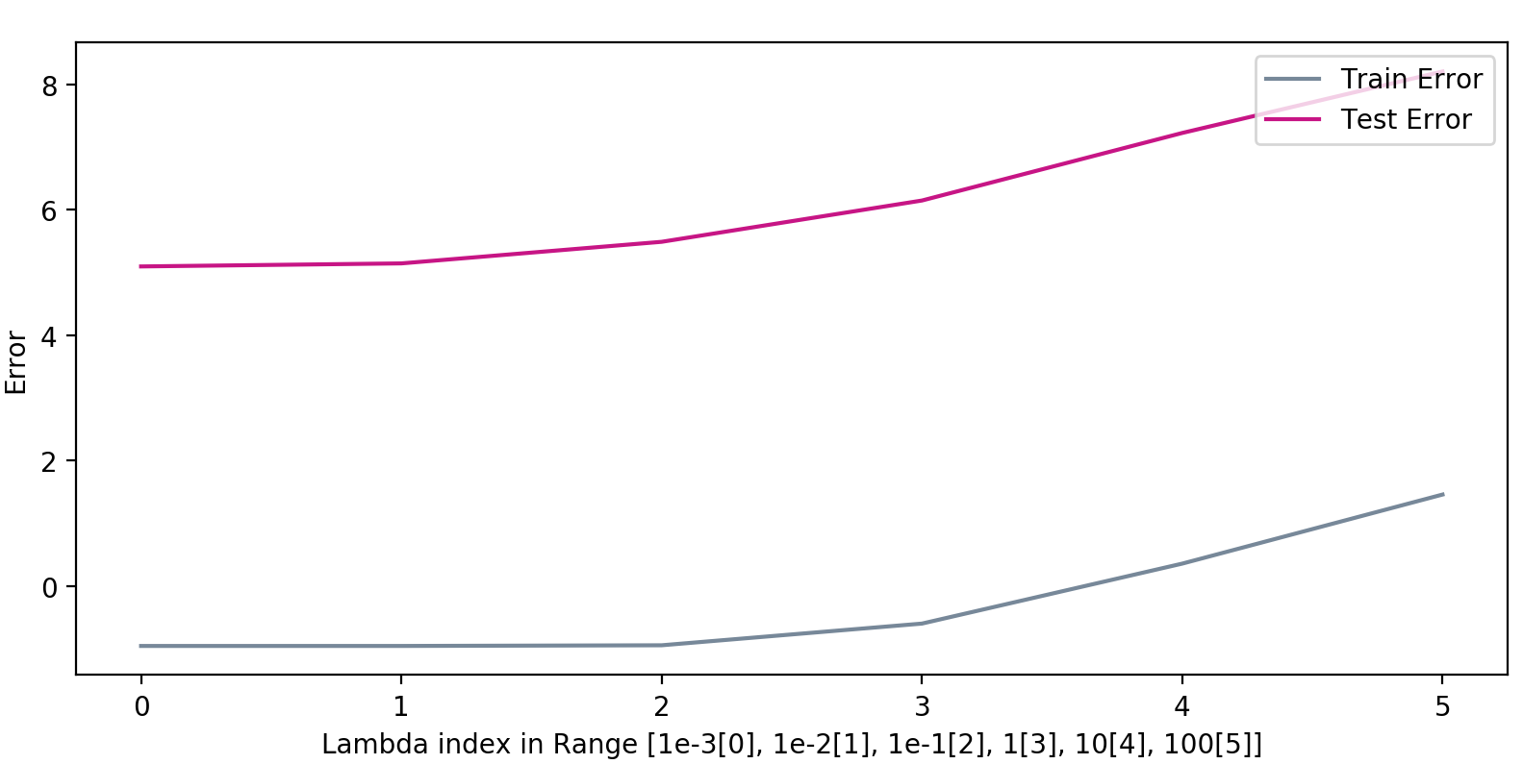
FIT OF THE MODEL
ƛ = 100 : Train and Test error both are very high : UNDERFIT
ƛ = 0.01 : both are stable and minimum : BEST-FIT after this test and train error starts increasing.
This correlates with the goodness fit measure

Slide 31
FINAL POLYNOMIAL REGRESSION MODEL
Polynomial Coefficients : 0.00000000e+00 6.93550528e+00 8.78616548e+00 7.08446796e+00 5.45249467e+00 5.80063154e+00 5.70665822e+00 8.70003833e+004.49965071e+00 -1.78521148e-06 6.17856419e-06
Intercept : 7.17396127
Variance : 0.1108132442535524
Optimal degree: 10
Optimal lambda: 0.01

Slide 32
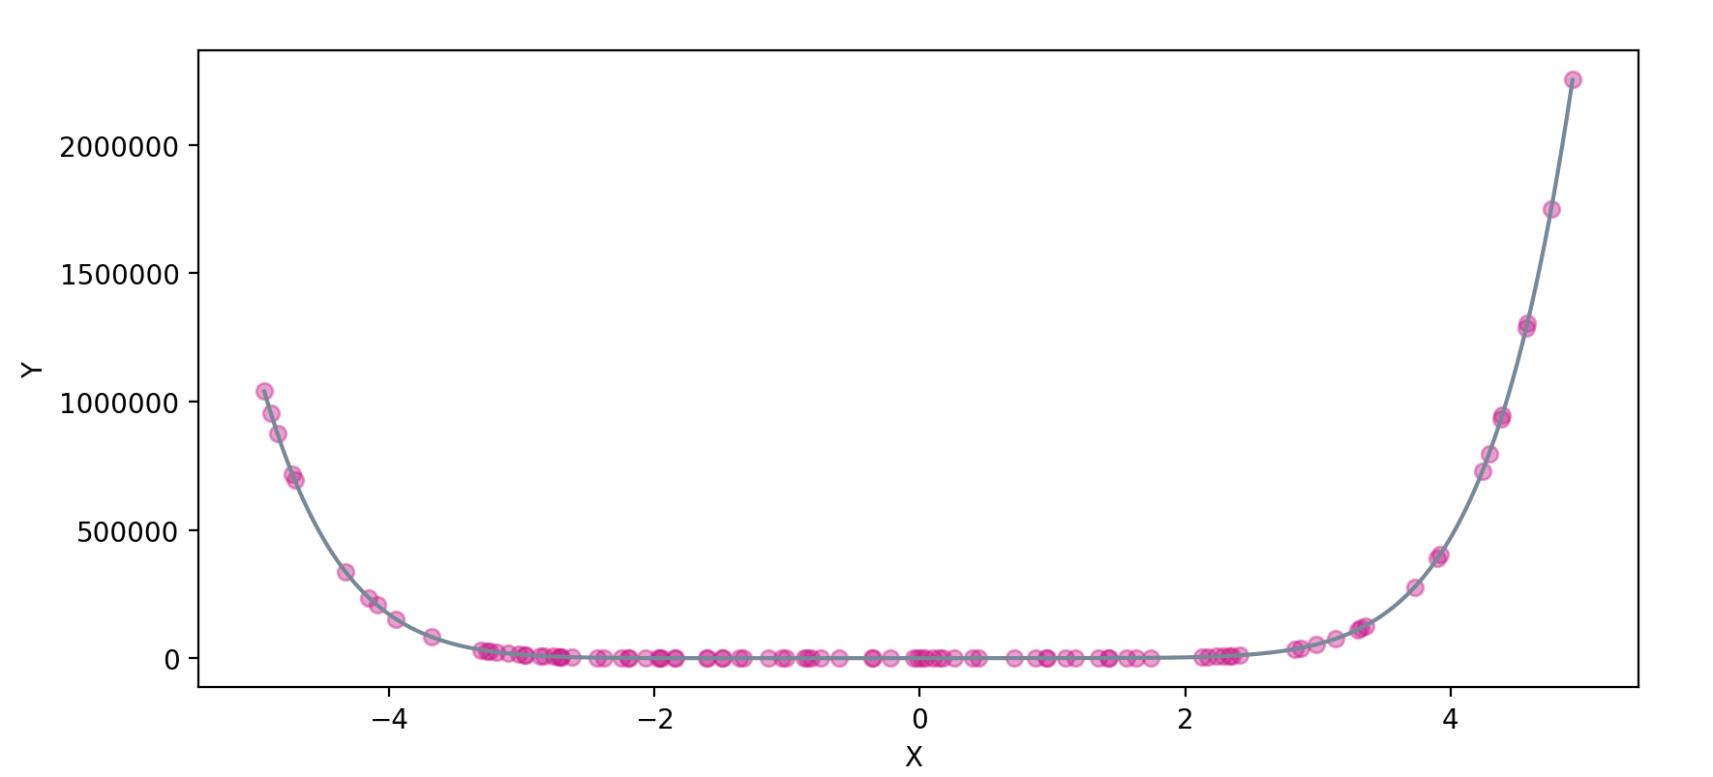
FITTING DATA TO MODEL

Slide 33
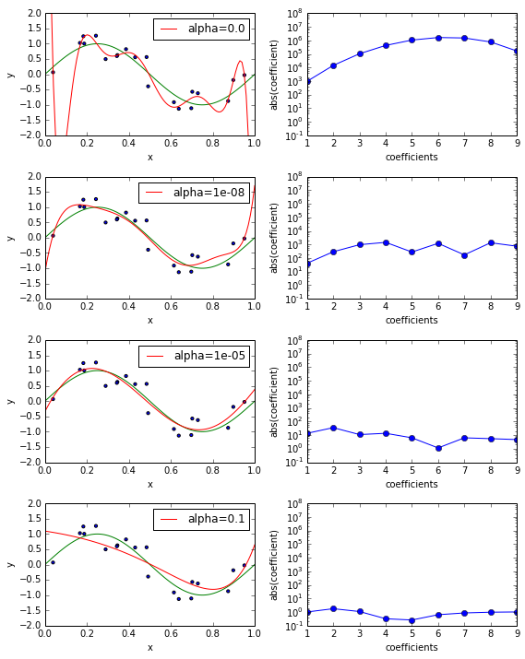
SIGNIFICANCE OF Lambda
The higher the value of lambda,
the lower would be the magnitude of the
polynomial coefficients. (under-fitting)
The lower the value of lambda
(approximately zero), the higher the value
of coefficients.(over-fitting)
In this case, the analysis approaches
the linear regression model.

Slide 34
Observation
For regression without Regularization and 20 data points the degree was 8 and for 100 data points optimal degree was 9 and variance increased and thus the fit.
For regression with Regularization and 20 data points the degree was 9 and for 100 data points optimal degree was 10 and variance increased and thus the fit.
Therefore, as we increase the data points the model learns better.

Slide 35
Genomic Sequence Analysis

Slide 36
Dataset Description
Non-coding ribonucleic acids (ncRNA) are believed to have many roles in a cell, many of which remain to be discovered. However, it is difficult to detect ncRNAs using biochemical screening methods. Recent studies have shown that computational methods can accurately detect ncRNAs, which can be treated as supervised classification. To perform the classification, an 8-dimensional feature vector is used as input to a classifier, including the length of genomic sequence and nucleotide frequencies:
A feature value computed by the Dynalign algorithm http://www.ncbi.nlm.nih.gov/pubmed/11902836
Length of shorter sequence
`A' frequencies of sequence 1
`U' frequencies of sequence 1
`C' frequencies of sequence 1
`A' frequencies of sequence 2
`U' frequencies of sequence 2
`C' frequencies of sequence 2
Number of training points = 2000
Number of testing points = 1001

Slide 37
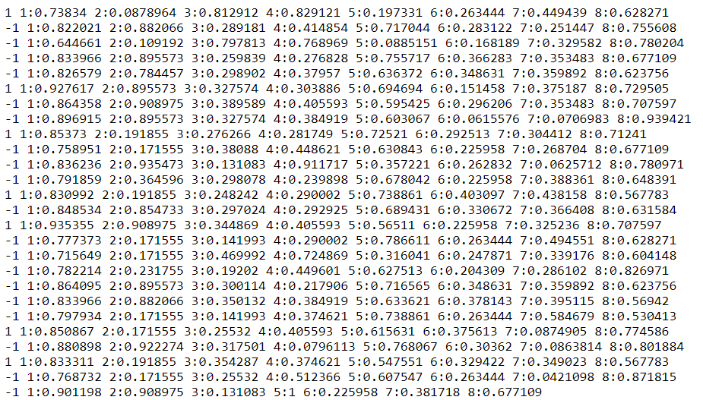
Training Data (2000)
Class labels: 1 and -1 Features: 1,2,3,4,5,6,7 and 8

Slide 38
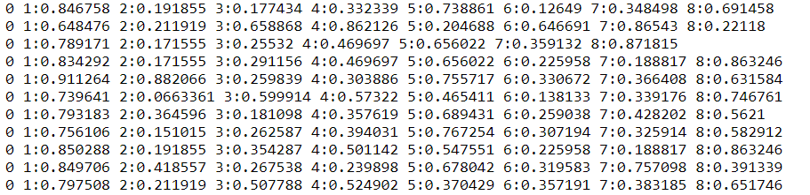
Test Data (1001)
Class labels: 0 (To be predicted) Features: 1,2,3,4,5,6,7 and 8

Slide 39
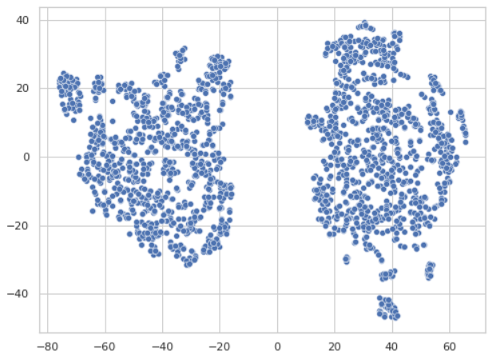
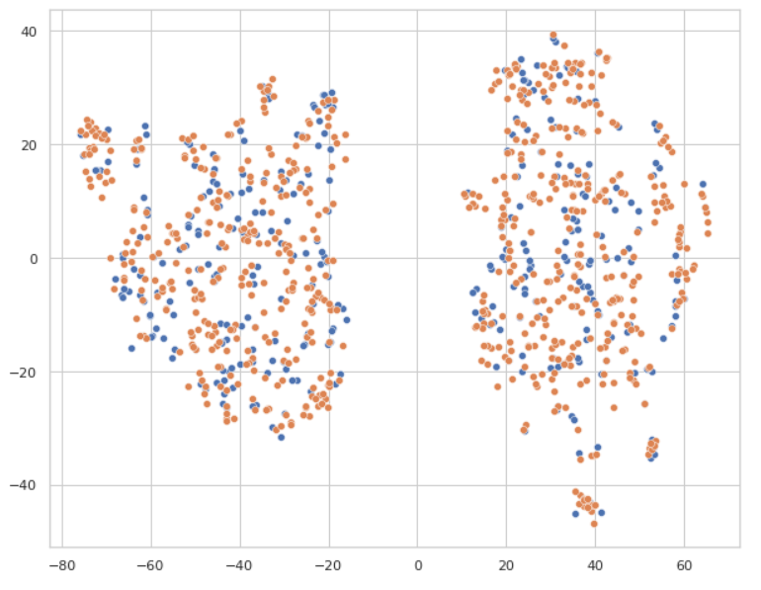
Data Visualization

Slide 40
Problem Statement 1: Classification using linear SVM
Spilt the training data set to form validation and training data sets.
Train a set of linear SVMs with different values of the regularisation parameter C using the training data set. For each value of C, train an SVM and use each trained SVM model to classify the validation data set.
C_values = [0.001, 0.01, 0.1, 1, 10, 100, 150, 200]
Maximum Accuracy : 95.5
Optimal Value of C is : 0.1

Slide 41
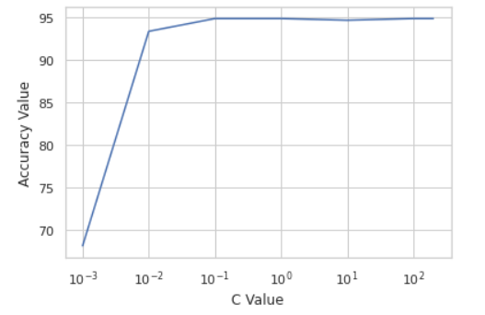
Results and Accuracy Plot as parameter of C
Coefficient of the optimal Classifier
[[ 3.21353503 -1.36975459 0.47045147
0.39591541 -0.00936292 0.58258025
0.42093817 0.16810366]]
Intercept of the optimal Classifier
[-0.9601014]
confusion_matrix:
[[662 23]
[ 22 293]]
Accuracy Array: [ 68.1 93.3 94.8 94.8 94.6 94.8 94.8 94.8]

Slide 42
Problem Statement 2: Classification using Gaussian(RBF) SVM
Use 5-fold cross validation to choose the best C and sigma To do so, first randomly choose 50% of the training set as the cross validation set. Next, divide the cross validation set into 5 subsets of equal size. Each subset is in turn used to validate the classifier trained on the remaining 4 subsets. So you will have 5 trained SVMs and 5 validation subsets. The cross validation accuracy is average accuracy over the 5 validation subsets.
|----> Train (1000)
Data ------>|-----> Validation (1000) ----> Cross validation (5 - fold)
|----> Test (1001)

Slide 43
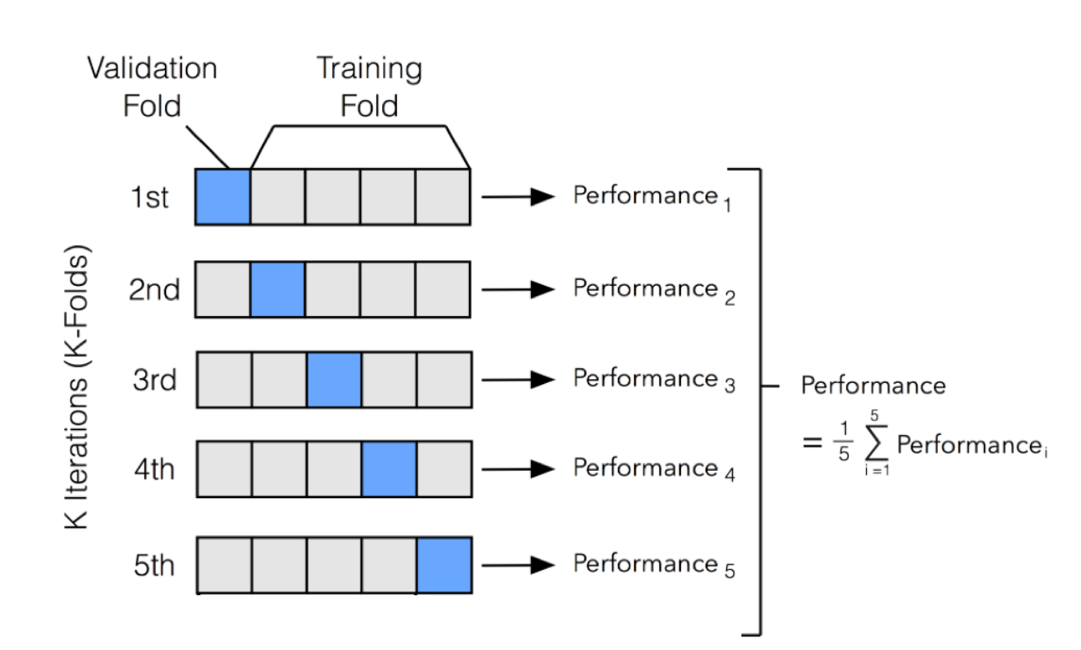

Slide 44
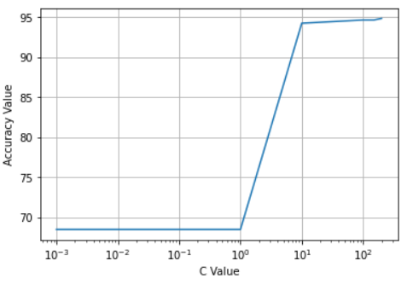
For both C and sigma try a number of different values and be sure to try all possible of pairs of values for C and sigma. Show a matrix of your cross validation results, where the entry (i, j) of the matrix corresponds to the classification accuracy on the cross validation set with ith value of C and j th value of sigma.
C_range = [0.001, 0.01, 0.1, 1, 10, 100, 150, 200]
gamma_range = [0.001,0.01, 0.1, 1, 10, 100, 150, 200]
Maximum Accuracy : 94.90
Optimal Value of C : 100
Optimal Value of Gamma : 0.001
Optimal Value of Sigma : 7.0710678118654755
Accuracy Matrix →

Slide 45
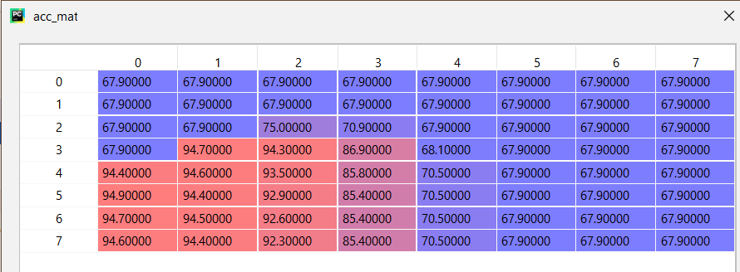
Accuracy Matrix

Slide 46
Next, use the entire training set to train an SVM classifier with the best C and \sigma values determined via the cross validation procedure outlined above. Finally, use the trained SVM model to classify the test data set and write the results to a file using the same format as the training data set.
Submitting with the code!!

Slide 47
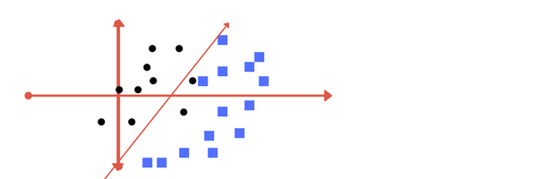
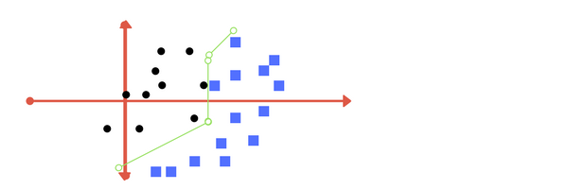
SIGNIFICANCE OF “C”
“C” is the regularisation parameter in python sklearn library.
Larger “C” leads overfitting and smaller “C” leads to underfitting.
The images below are examples of two different regularization parameter. Left one has some misclassification due to lower regularization value. Higher value leads to results like right one.

Slide 48
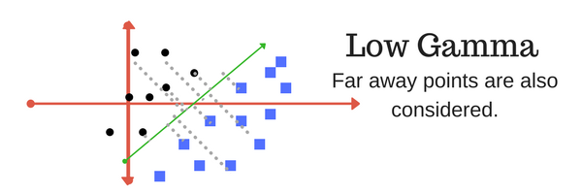
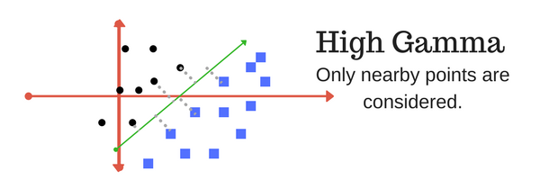
SIGNIFICANCE OF “Gamma/Sigma”
Lower “gamma” leads to consideration of the points that are far away from the possible decision boundary in the calculation of the actual decision boundary.
Higher “gamma” leads to consideration of the points that are nearer to the possible decision boundary in the calculation of the actual decision boundary.

Slide 49
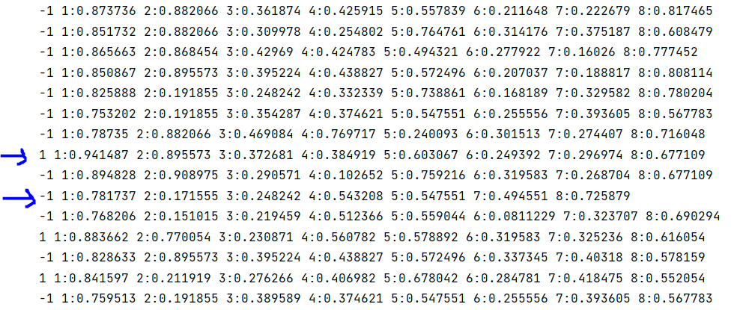
SVM Output

Slide 50
Thank You

